Slide 1
14-795 · FINAL PRESENTATION · APR 2026
VoiceGuard
Voice-Cloning Attack & Detection
Jerry Zeng + teammate
A Gradio app that both clones voices and catches them.

Slide 2
Goals
Rubric: 5 pts
What we set out to build
Refined goal after Challenge Analysis
A single tool where anyone can:
Attack — clone a voice from 3–30 s of reference audio
Shield — detect AI-generated speech with verdict + explanation
Why now:
Voice-cloning scams projected at $40 B by 2027
No open tool pairs clone + detect in one interface
Not just "does it work?"
→ "is the detection calibrated and generalizable beyond the benchmark?"
This framing drives every Results slide →
VoiceGuard · 2 / 13

Slide 3
System — Two-Tab Gradio App
Rubric: 5 pts
ATTACK · clone a voice
SHIELD · detect deepfake
OpenVoice v2 (MyShell)
Speaker embedding
MeloTTS base waveform
Tone-color conversion
Inputs:
3–30 s reference audio + free text
Outputs:
Cloned .wav + similarity score (0–100 %)
W2V-AASIST (Tak et al. 2022)
wav2vec 2.0 XLSR (300 M params)
AASIST graph-attention backend
Softmax → spoof_prob
Outputs:
Verdict: REAL / SUSPICIOUS / FAKE
Confidence (0 – 100 %)
8-feature acoustic dashboard
Attention heatmap + spectrogram
→
Send to Shield
Live demo end-to-end in < 30 s
VoiceGuard · 3 / 13

Slide 4
Replicated vs. Added
Rubric: 5 pts (System)
Component | Source | Our change
OpenVoice v2 | MyShell (MIT) | used as-is
W2V-AASIST + best_SSL_model_DF.pth | Tak et al. (MIT) | used pretrained weights
Gradio two-tab app | — | built from scratch
"Send to Shield" workflow | — | built from scratch
AASIST attention heatmap overlay | — | attention × mel spectrogram
8-feature acoustic dashboard | librosa | dashboard + UI integration
Dataset-wide eval pipeline | — | scripts/eval_asvspoof.py (71 k eval)
Feature-distribution calibration | — | scripts/analyze_eval.py
In-the-wild domain-gap test | — | scripts/in_the_wild_test.py
VoiceGuard · 4 / 13

Slide 5
Demo — Attack → Shield
Rubric: 5 pts (Results)
1. Upload
2. Clone
3. Send to Shield
4. Verdict
10-second
reference clip
OpenVoice v2
generates cloned .wav
single-click
hand-off
FAKE
@ 99.97 %
LIVE DEMO · end-to-end < 30 s
Attack: Upload → Clone & Speak → cloned audio + similarity score
Shield: Send to Shield → verdict FAKE @ 99.97 % + attention heatmap highlighting artifact bands
Demo recording available · fallback if live demo fails
VoiceGuard · 5 / 13

Slide 6
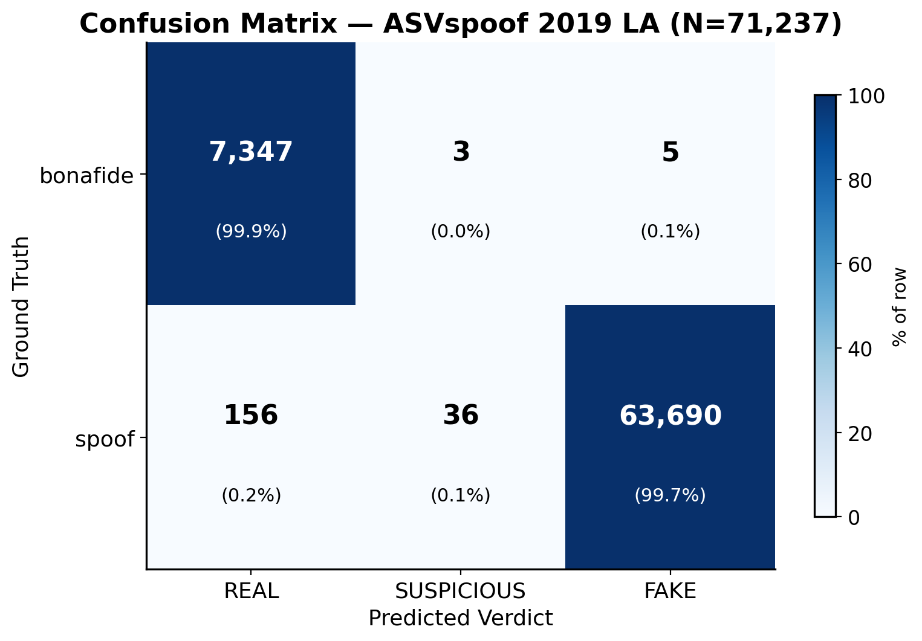
Results — ASVspoof 2019 LA (full eval)
Rubric: 5 pts (Results)
0.146 %
EER (paper reports ~0.7 %)
99.77 %
Overall Accuracy
0.109 %
FPR 8 / 7,355 bonafide
0.244 %
FNR 156 / 63,882 spoof
N = 71,237 · 7,355 bonafide + 63,882 spoof · 8 h 14 min on 4 CPU workers
VoiceGuard · 6 / 13

Slide 7
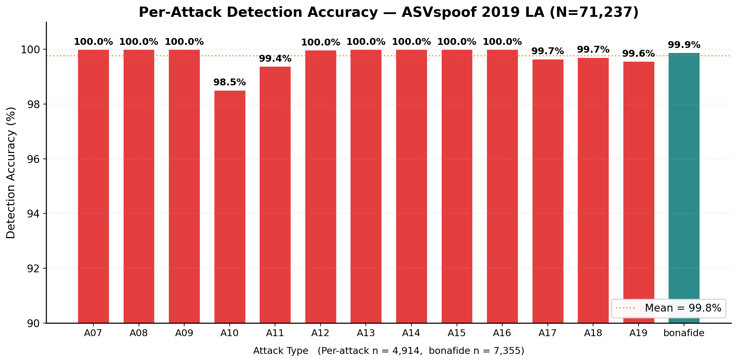
Results — 13 Deepfake Attack Types
Rubric: 5 pts (Results)
Takeaways
7 / 13 attacks detected at 100.0 %
Hardest: A10 (98.5 %) — end-to-end TTS w/ WaveNet vocoder
Runner-up: A11 (99.4 %) WaveRNN, A19 (99.6 %) transfer TTS+VC
Mean detection: 99.8 % — no attack is a systemic blind spot
Each bar ≈ 4,914 utterances
Detection generalizes across TTS, VC, and neural-vocoder synthesis methods at scale.
VoiceGuard · 7 / 13

Slide 8
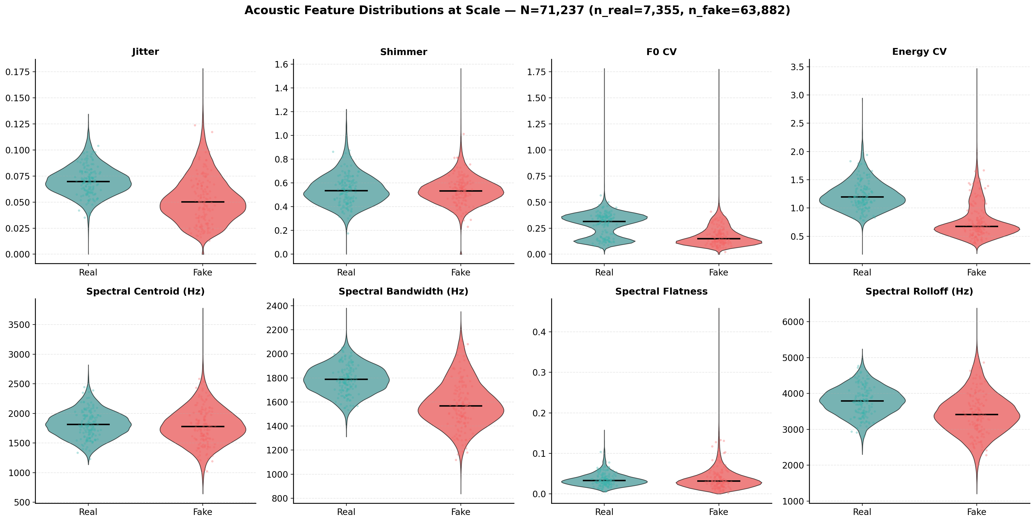
Results — Feature Calibration at Scale
Rubric: 5 pts (Results)
14
samples before
(Challenge Analysis)
71,237
samples now
Nearly 5,000× more
Answers Challenge-Analysis weakness #2
Shimmer, F0 CV, Energy CV separate cleanly — ready for UI percentile context.
Violin plots: black line = median; colored region = kernel density.
VoiceGuard · 8 / 13

Slide 9
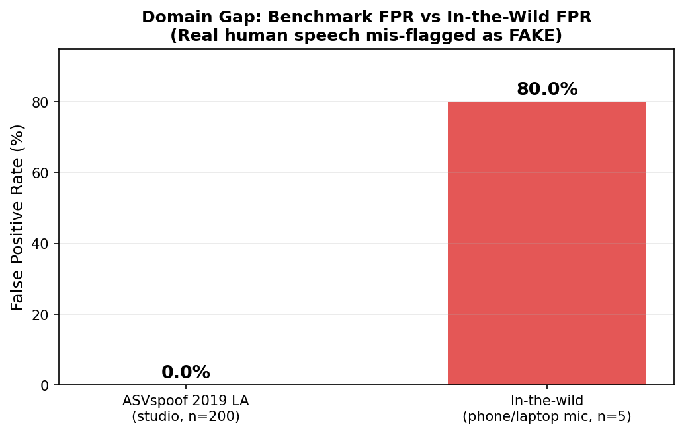
The Gap We Found
⭐ headline finding
0.109 %
FPR on ASVspoof 2019 LA
studio-quality, 7,355 real utterances
80.0 %
FPR on in-the-wild real humans
phone / laptop mic, n = 5
~ 730×
FPR increase from benchmark → wild
On its own benchmark, the model is near-perfect. On everyday audio, 4 / 5 real humans are mis-flagged as AI.
VoiceGuard · 9 / 13

Slide 10
Future Work — one step
Rubric: 5 pts
Domain-adaptive fine-tuning on diverse real-world speech
Data — collect ≥ 1,000 hrs real human audio
Resources — think big
Phone codecs (µ-law, Opus, GSM)
Consumer mics (laptop, earbuds, headset)
Noisy conditions (café, car, wind)
50+ demographically diverse speakers
Pool with ASVspoof, fine-tune end-to-end
1 × A100-week GPU for fine-tuning
~ 2 FTE-months for data collection + labelling
$5–10 k microphones + speaker honoraria
Re-evaluate on both benchmark and new in-the-wild set
VoiceGuard · 10 / 13

Slide 11
Justification — evidence from our eval
Rubric: 5 pts
1
2
Benchmark FPR is already near-zero
In-the-wild FPR is catastrophic
0.109 % (8 / 7,355 real). A bigger / deeper model
won't help when you're already at the floor.
80 % (4 / 5 real humans). A ~730× degradation that
scales with distribution mismatch, not model size.
3
4
The architecture is fine — data isn't
Features already separate real / fake
W2V-AASIST paper: EER ~0.7 % when train ≈ test.
Our reproduction: EER 0.146 % — within range.
At 71 k scale, shimmer / F0-CV / energy-CV
distributions split cleanly → signal exists, domain doesn't.
→ Fine-tuning on diverse real speech is a higher-leverage investment than architectural changes or a bigger model.
VoiceGuard · 11 / 13

Slide 12
Summary
1
Built
an integrated clone + detect tool — attack → shield in < 30 s
2
Benchmarked
at full scale: 99.77 % accuracy, 0.109 % FPR, EER 0.146 % (N = 71,237)
3
Found
80 % FPR on in-the-wild real humans — ~730× benchmark FPR
4
Recommend
collect diverse real-world speech + domain-adapt fine-tune
VoiceGuard · 12 / 13

Slide 13
Q&A
Thanks for listening.
Anticipated: why 2019 LA? · 5 in-the-wild samples? · fine-tune in-house? · heatmap as explanation?

